Slide 1
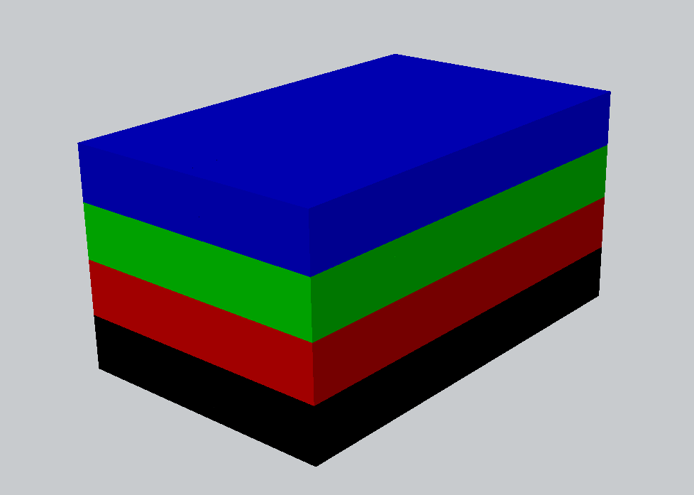
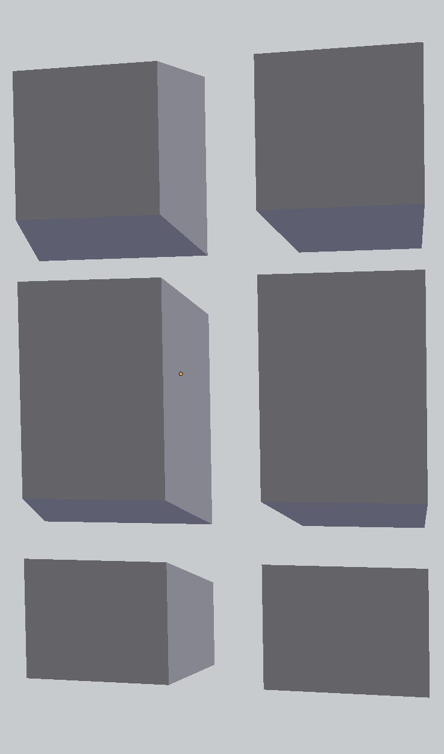
Chunk 0
Print Time:
2253
Chunk 1
Print Time:
1899
Chunk 2
Print Time:
2929
Chunk 3
Print Time:
2490
Chunk 4
Print Time:
1429
Chunk 5
Print Time:
1236
(A) Tall Box Layers
(B) Chunk Configuration
Layers 0-3

